Slide 1





Tutoriais | Intro
+
01 / 10 (segunda-feira)
08 / 10

Slide 2
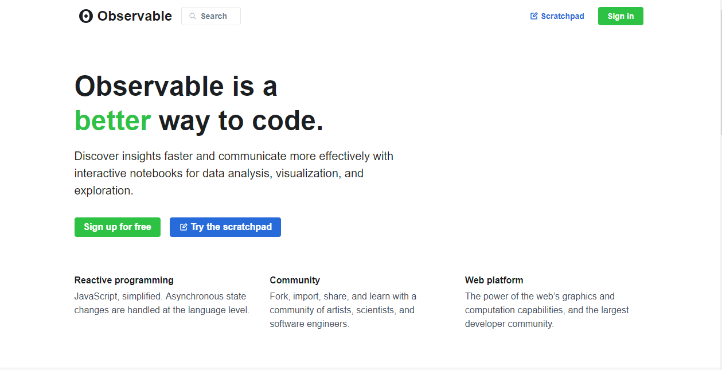
beta.observablehq.com

Slide 3
Content
1 D3 Intro
2 Observable notebooks
3 D3 Basics
4 Working with D3 in Observable
5 Running D3 locally
https://beta.observablehq.com/d/0add62c9618c972f

Slide 4
Content
1 D3 Intro
2 Observable notebooks
3 D3 Basics
4 Working with D3 in Observable
5 Running D3 locally

Slide 5
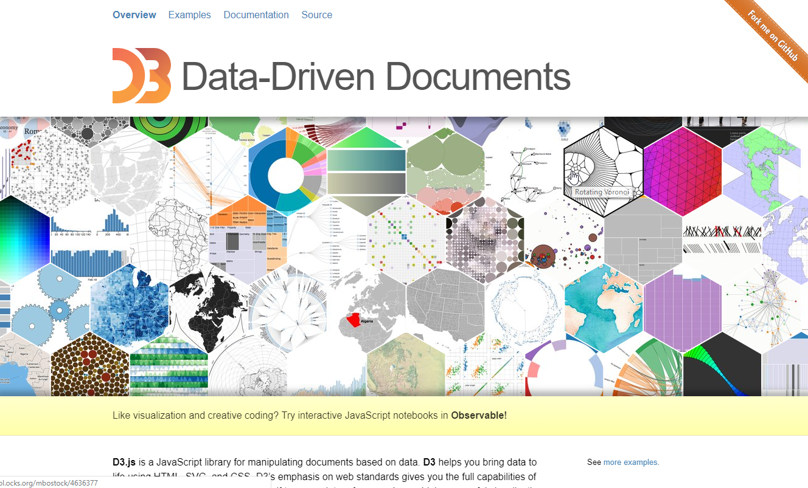
Why D3?

Slide 6
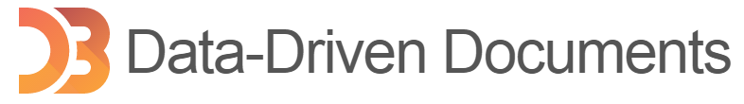
D3.js
“D3” stands for Data-Driven Documents
is a JavaScript library for manipulating documents based on data
works with web standards (HTML, SVG, and CSS)
HyperText Markup Language (HTML)
Scalable Vector Graphics (SVG); XML-based vector image format for graphics
Cascading Style Sheets (CSS); separation of document content from document presentation
Runs in modern browsers, no proprietary framework

Slide 7
Before showing beautiful graphics…

Slide 8

What D3 is all about…?
HTML page
The Document Object Model (DOM)
SVG (Scalable Vector Graphics)
<html>
<head>….</head>
<body>
D3.js
interaction with:
<div>
…
</div>
Data
<div>
…
</div>
. . .
</body>
</html>

Slide 9


History
Rich internet applications
Java applet
Flash

Slide 10
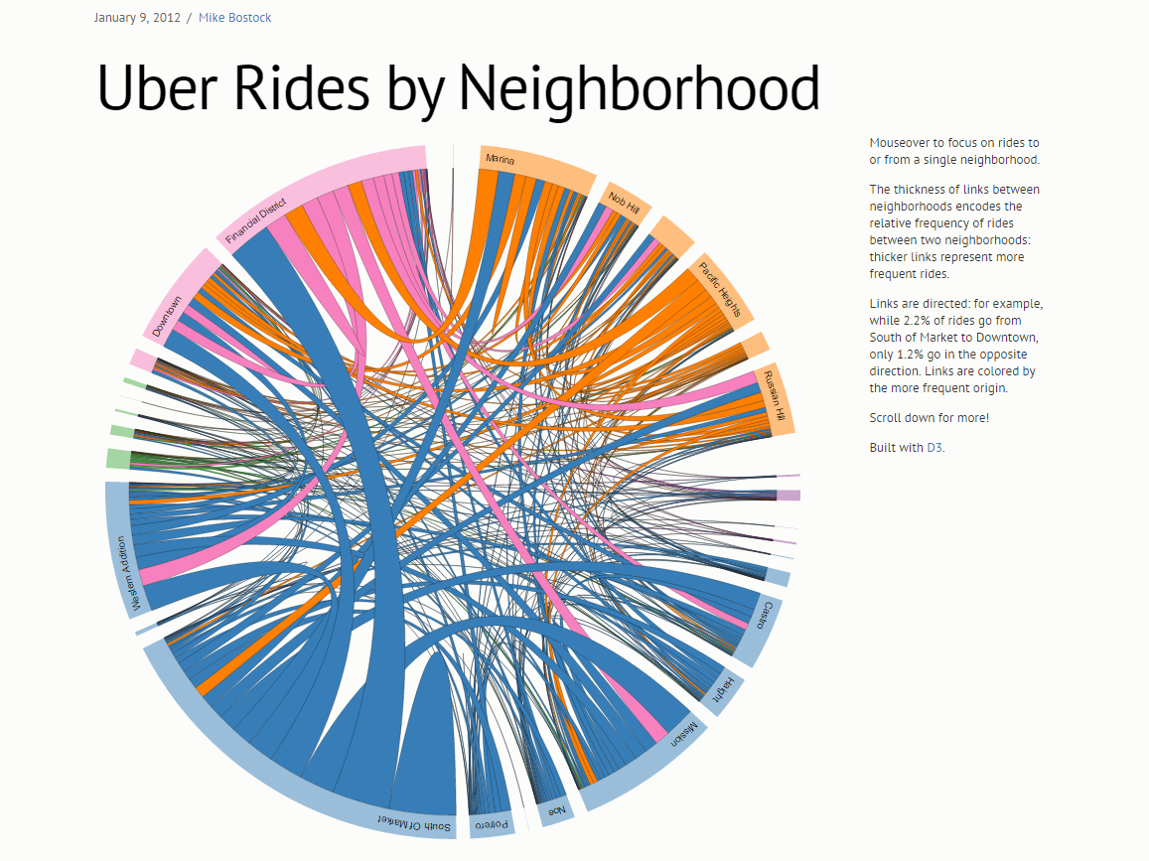
HTML5 + JavaScript (D3 also..) + CSS
No need to install any plugin
Run on any platform (iOS, Android, Desktops, ..)
http://bost.ocks.org/mike/uberdata/

Slide 11
Content
1 D3 Intro
2 Observable notebooks
3 D3 Basics
4 Working with D3 in Observable
5 Running D3 locally

Slide 12
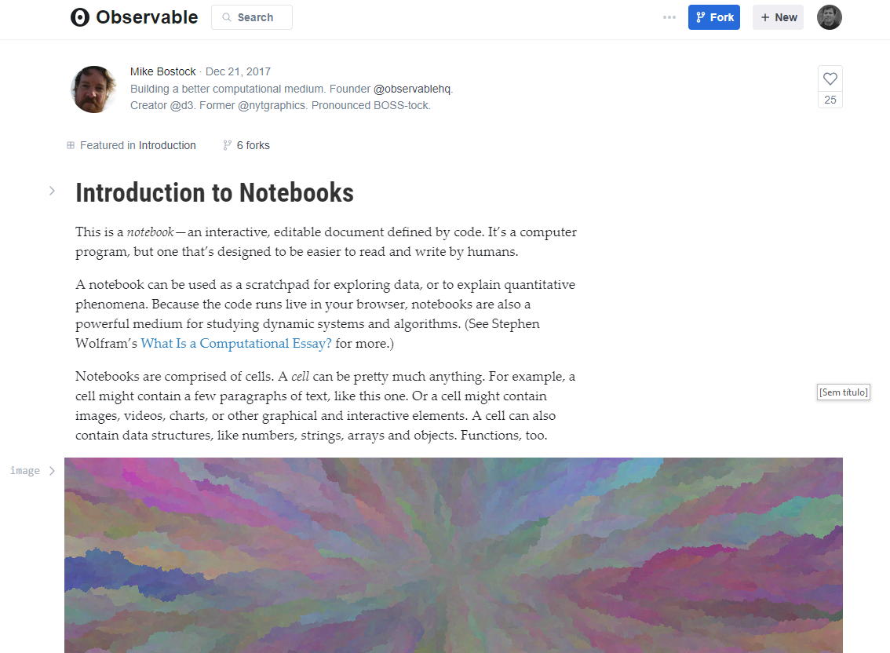
https://beta.observablehq.com/@mbostock/introduction-to-notebooks

Slide 13
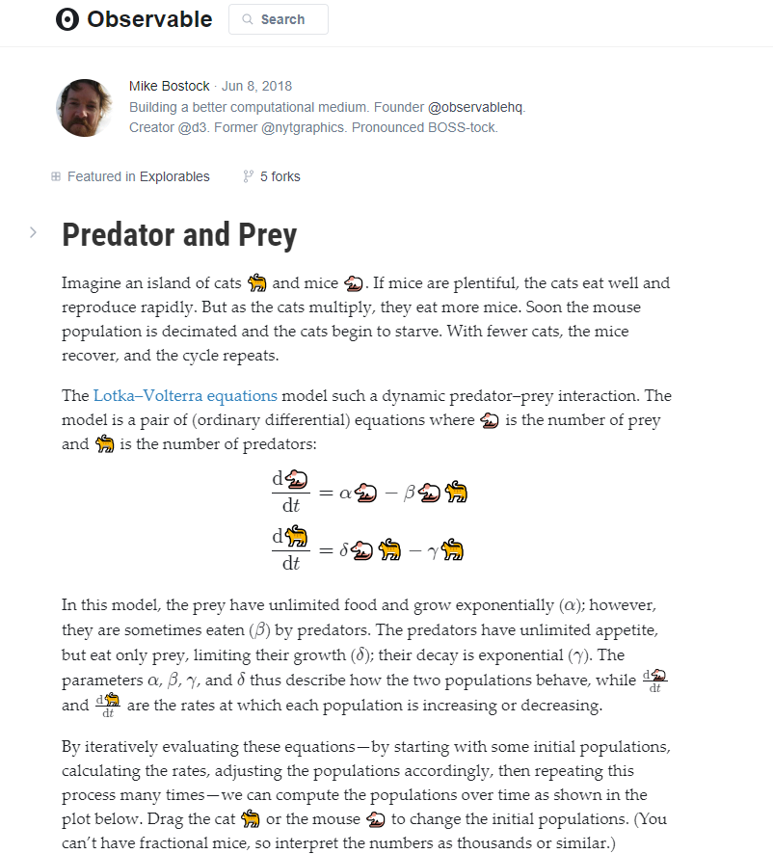
https://beta.observablehq.com/@mbostock/predator-and-prey

Slide 14
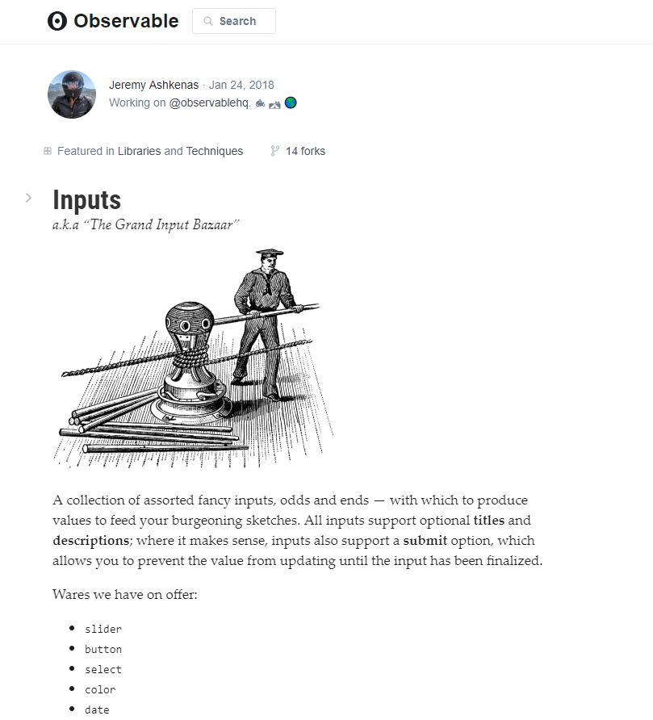
https://beta.observablehq.com/@jashkenas/inputs

Slide 15
Content
1 D3 Intro
2 Observable notebooks
3 D3 Basics
4 Working with D3 in Observable
5 Running D3 locally

Slide 16
D3 “chain syntax”
d3.select("body").append("p").text("New paragraph!");
..or for better legibility:
d3.select("body")
.append("p")
.text("New paragraph!");
JavaScript, like HTML, doesn’t care about whitespace and line breaks.
Now, the same code without chain syntax:
var body = d3.select("body");
var p = body.append("p");
p.text("New paragraph!");
Reference: http://alignedleft.com/tutorials/d3/chaining-methods

Slide 17
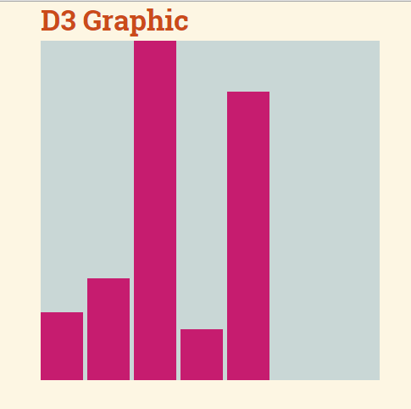
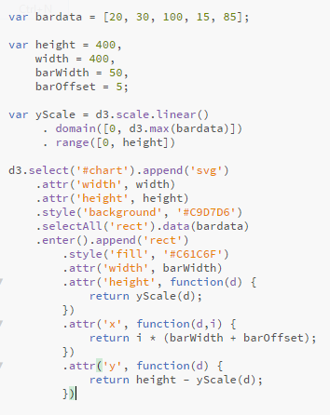
Loading data
Arrays

Slide 18
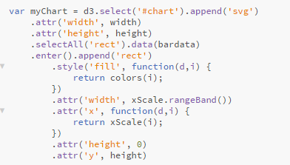
Flexibility for varying sizes of input data
Short example – data driven approach
“Empty” selection
Adding elements
Looping through data (but not with an explicit “for” loop).

Slide 19
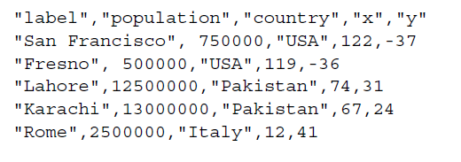
Loading data
CSV files
d3.csv("somefiles.csv", function(data) {doSomethingWithData(data)});

Slide 20
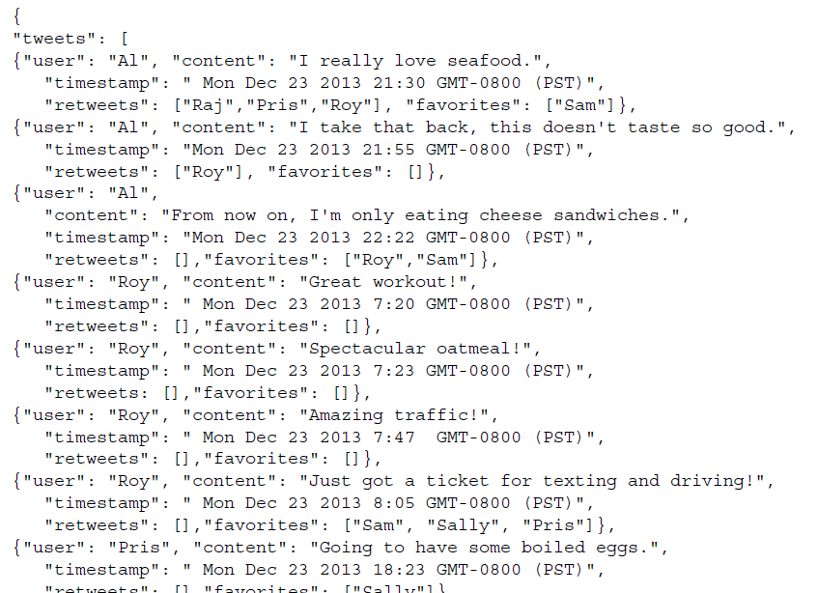
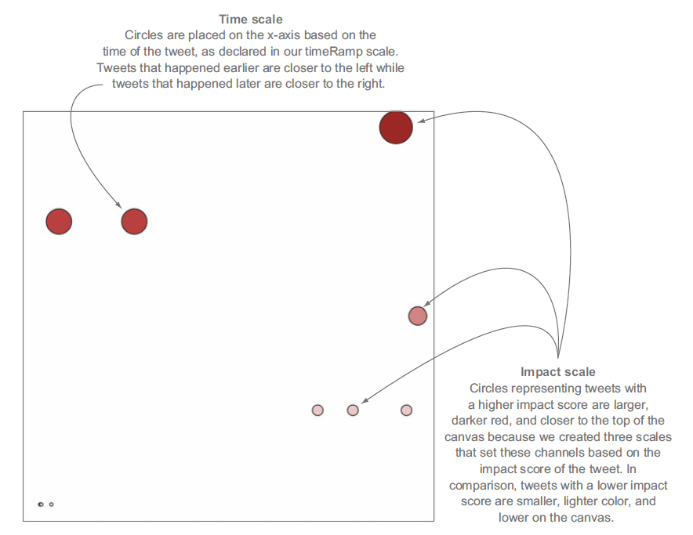
Loading data
JSON files
d3.json("tweets.json", function(data) {doSomethingWithData(data)});
(Meeks, Elijah. "D3. js in Action." (2015))

Slide 21
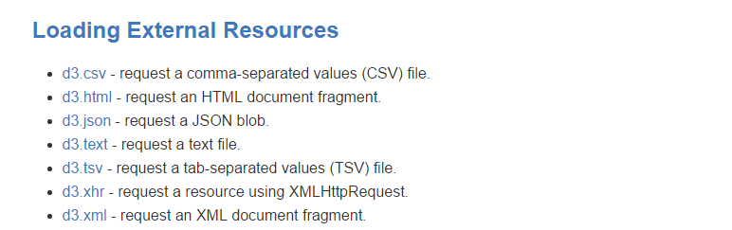
Loading data
..and also:
D3 API Reference
https://github.com/d3/d3/blob/master/API.md

Slide 22
Selecting elements
d3.selectAll("body").style("background-color", "black");
Or by class:
d3.selectAll(".container")…
Or by ID:
d3.select("#dataPoint1“)…

Slide 23
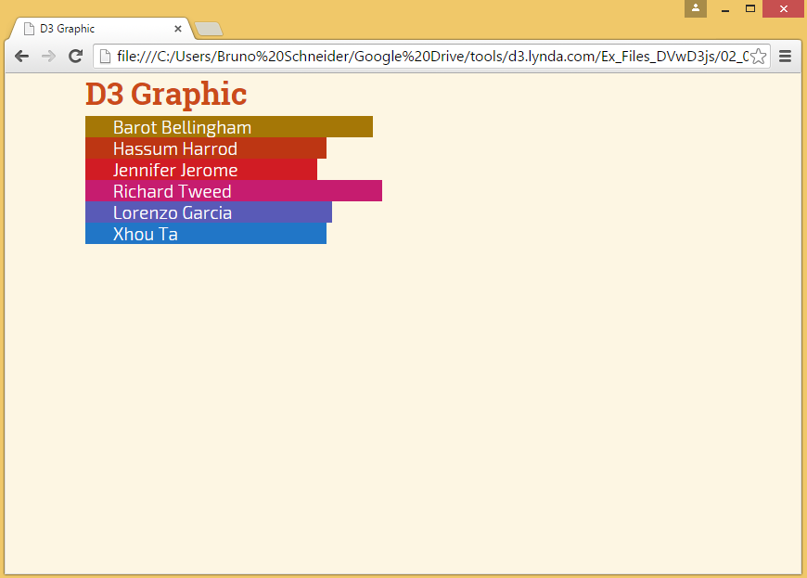
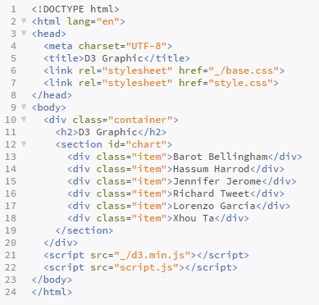
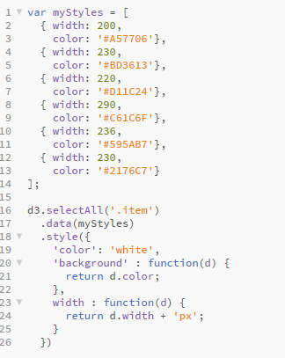
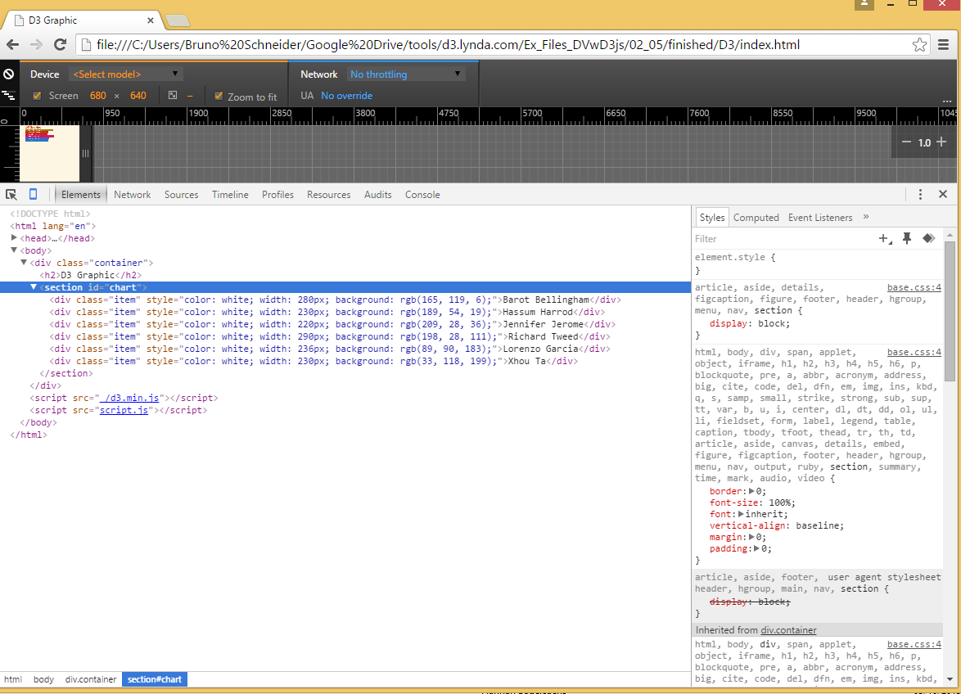
D3 selection: example
index.html
script.js

Slide 24
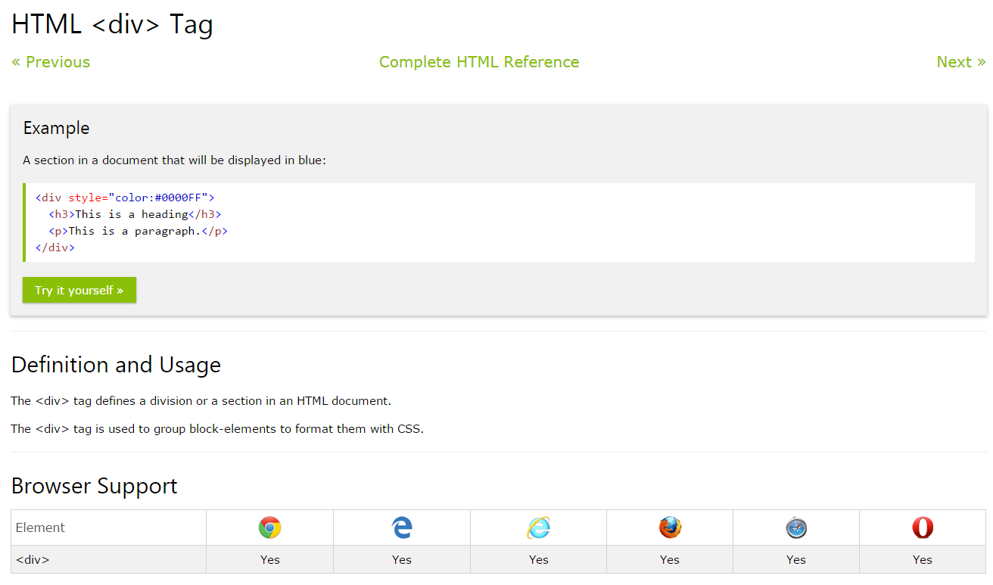
HTML <div> tag

Slide 25
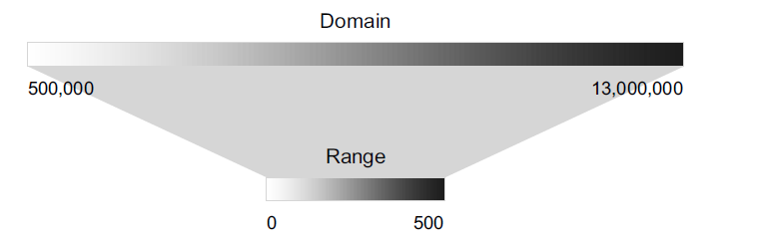
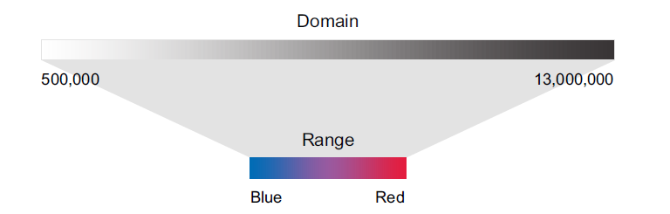
D3 scales

Slide 26
Content
1 D3 Intro
2 Observable notebooks
3 D3 Basics
4 Working with D3 in Observable
5 Running D3 locally
https://beta.observablehq.com/d/0add62c9618c972f

Slide 27
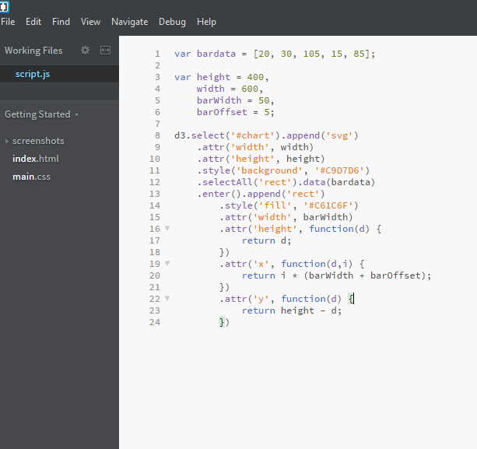

Slide 28
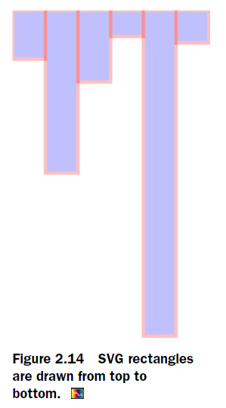
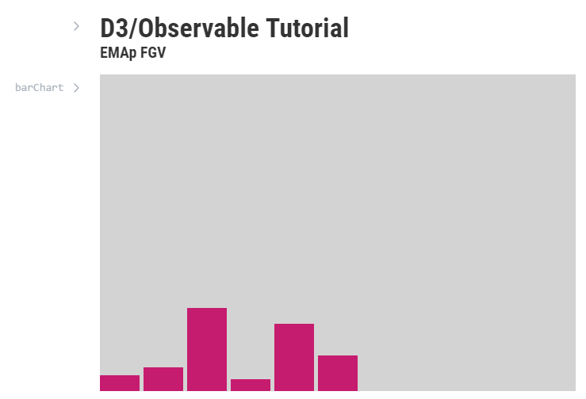
https://beta.observablehq.com/d/0add62c9618c972f

Slide 29
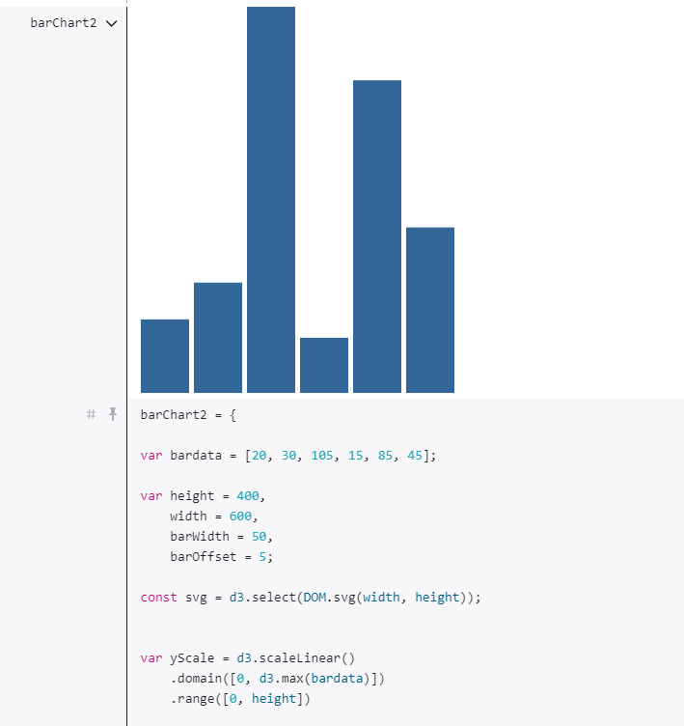
https://beta.observablehq.com/d/0add62c9618c972f

Slide 30
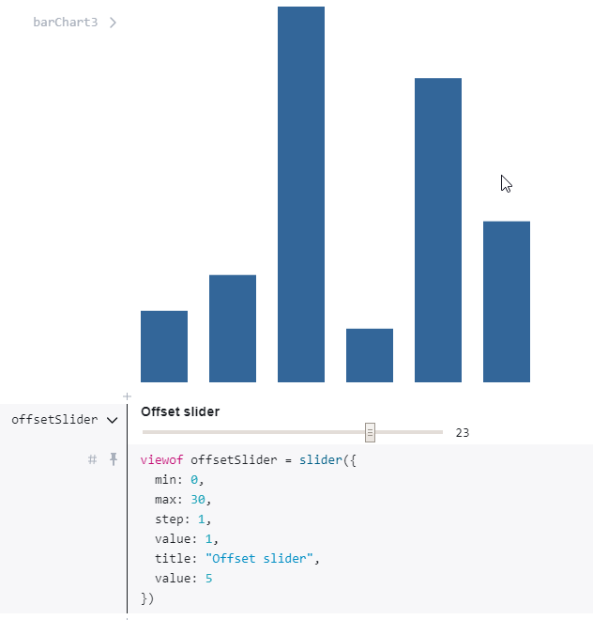
https://beta.observablehq.com/d/0add62c9618c972f

Slide 31
Content
1 D3 Intro
2 Observable notebooks
3 D3 Basics
4 Working with D3 in Observable
5 Running D3 locally

Slide 33
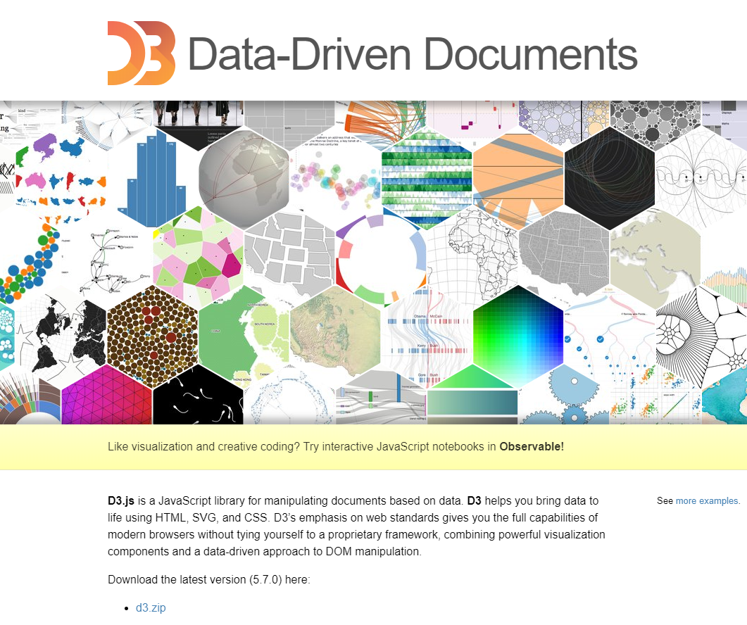
Downloading D3
http://d3js.org/

Slide 34
Organizing the code
D3 code here
.html file
.css file
1.
+
D3 code here
.html file
.js file
.css file
2.
+
+
(preferred way)

Slide 35
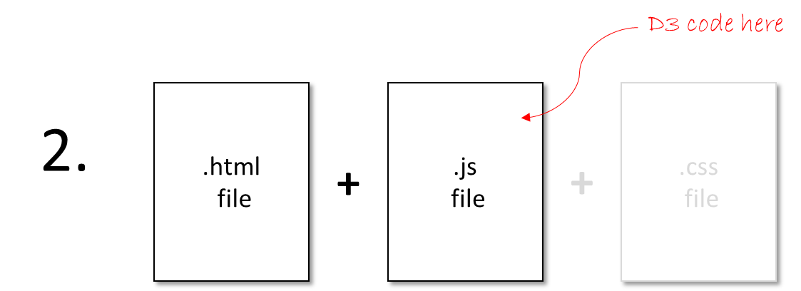
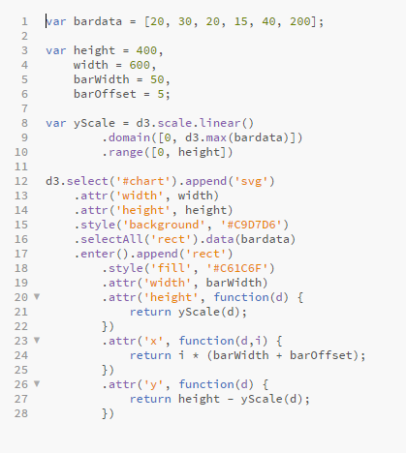
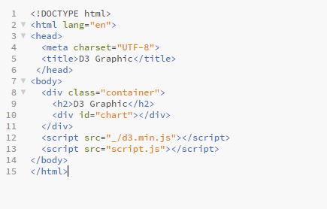
Example
script.js

Slide 36
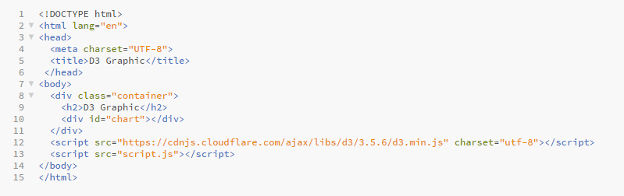
Loading D3.js
Local storage
OR
Online
.html file
.html file

Slide 37
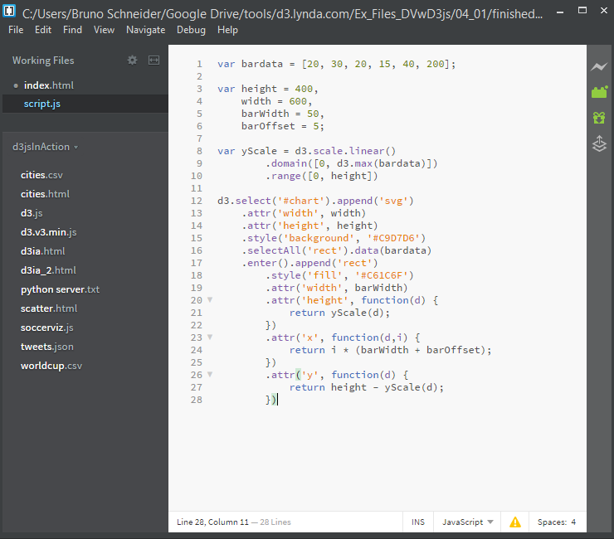
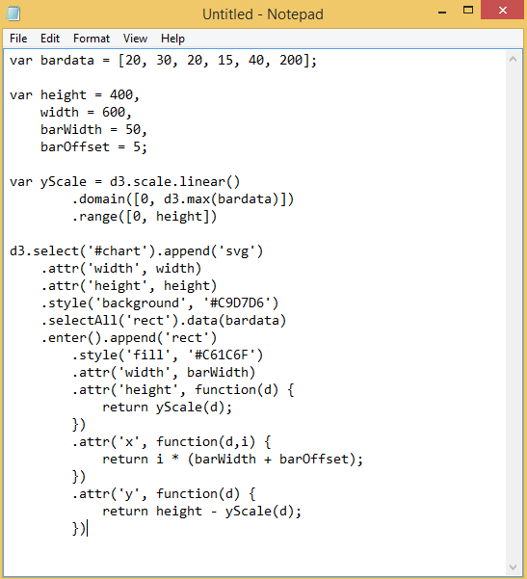
Working with D3
Any text editor, HTML/Javascript IDE of your choice

Slide 38
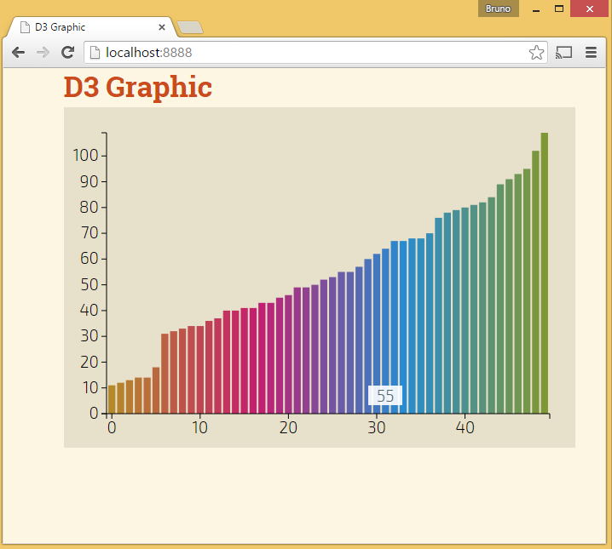
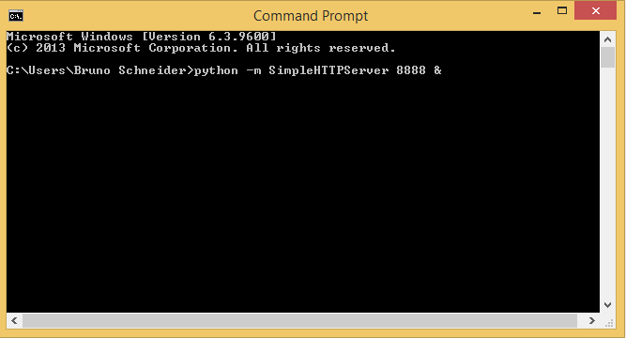
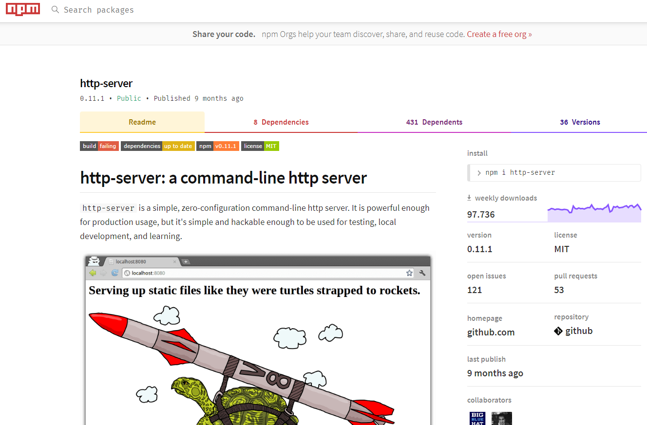
Working with D3
running Python's built-in server
.. Or npm http-server
python -m SimpleHTTPServer 8888 &
.. due to restrictions of the browser for reading external files

Slide 39
The developer tools in Chrome
Show example
Shows the current state of the DOM
More tools / Developer tools

Slide 40
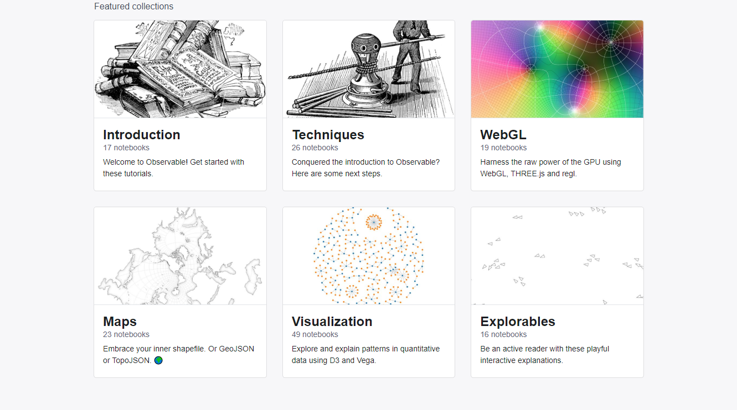
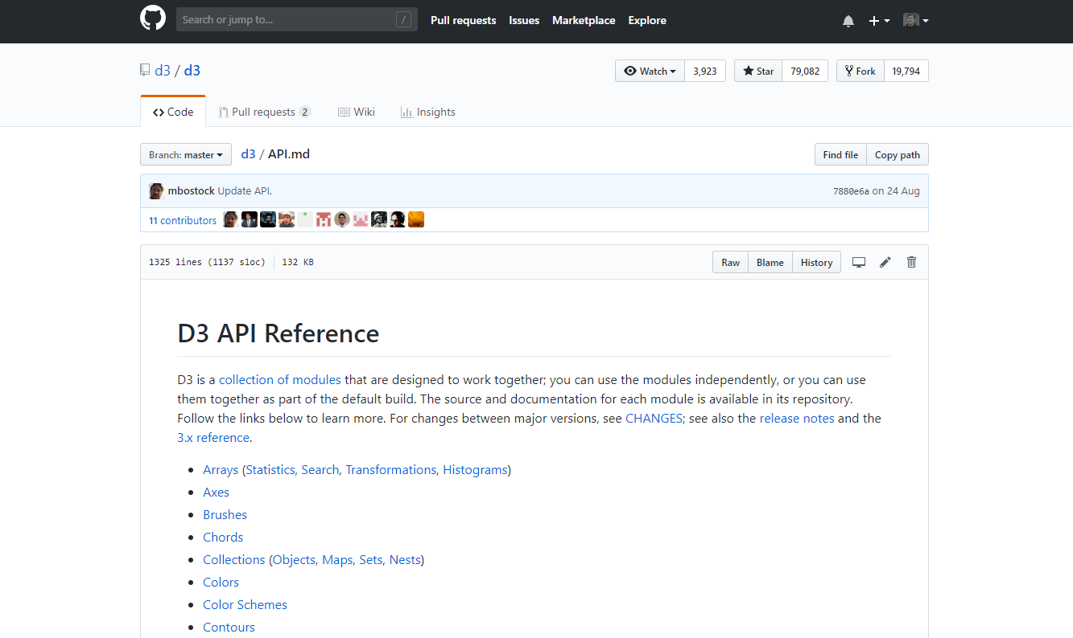
References
beta.observablehq.com
https://github.com/d3/d3/blob/master/API.md

Slide 41
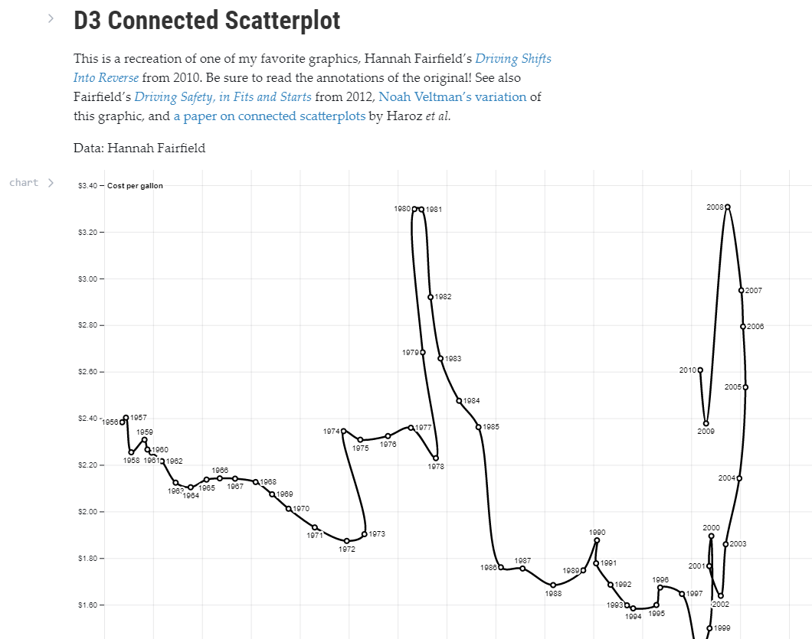

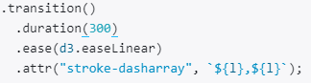
References
https://beta.observablehq.com/collection/@observablehq/visualization

Slide 42
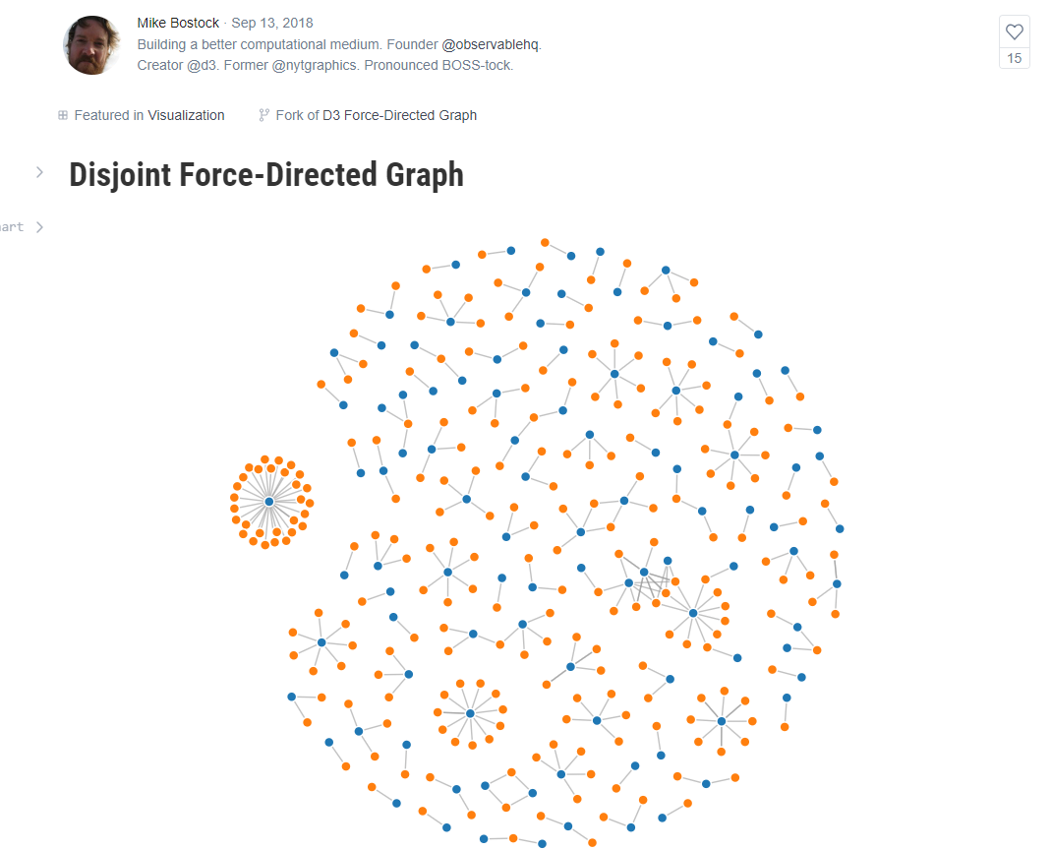
References
https://beta.observablehq.com/collection/@observablehq/visualization

Slide 43
Muito obrigado pela atenção...!
08 / 10

Slide 44
EXTRA SLIDES

Slide 45
Generators, Layouts
Layouts
stack(), pie(),
chord()…
Generators
area(), line(),
diagonal(), arc()…

Slide 46
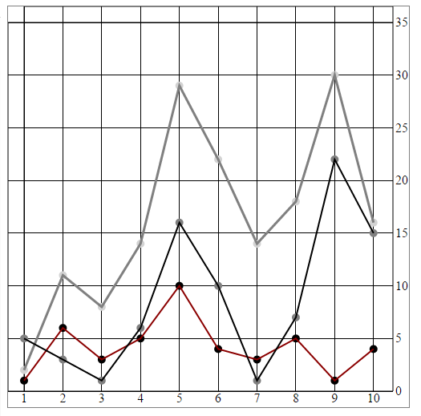
Line charts
http://bl.ocks.org/emeeks/5901fbf392bcc55197b2

Slide 47
d3.svg.line()
Example of a “Generator”
What they produce
Generators
area(), line(),
diagonal(), arc()…
SVG drawing code
for <path> elements:
"M-23,-13,24 0 0,1 -21,-11L-17,
-91A200,200 0 0,0 -19,-11Z"
Generators
D3 generators consist of functions that take data and return the necessary SVG drawing code to create a graphical object based on that data.

Slide 48
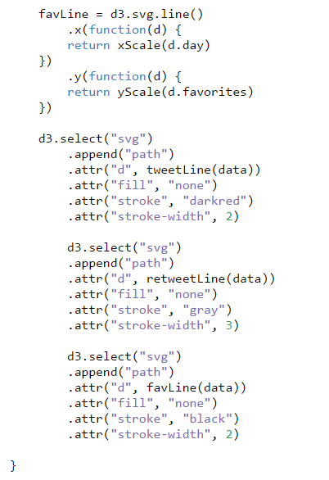
Line charts
d3.svg.line()
Generator that draws a line from points
Each line generator needs to be called by a corresponding new <path> element

Slide 49
d3.layout.pie()
Example of a “Layout”
What they produce
Layouts
stack(), pie(),
chord()…
New annotated datasets
with attributes for graphical
layout of datapoints
Layouts
Take in one or more arrays of data, and sometimes generators, and append attributes to the data necessary to draw it.

Slide 50
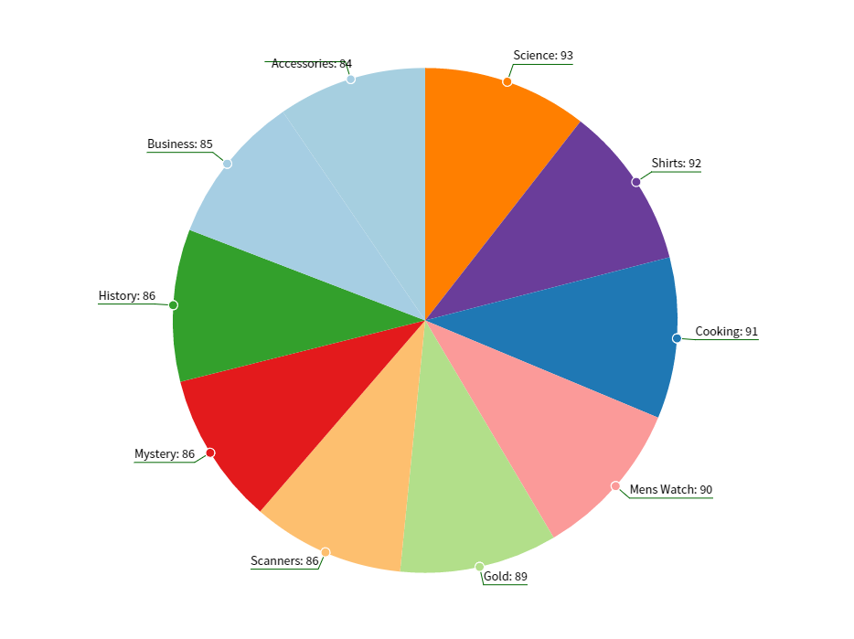
Pie Charts
http://bl.ocks.org/emeeks/8ae722e392d4ef9f2aa9

Slide 51
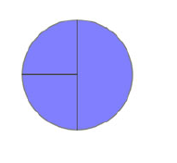
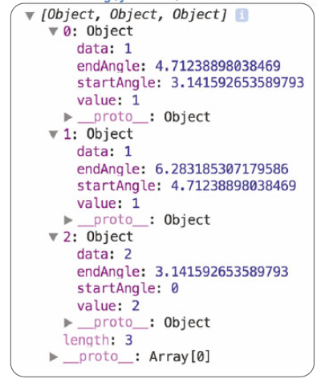
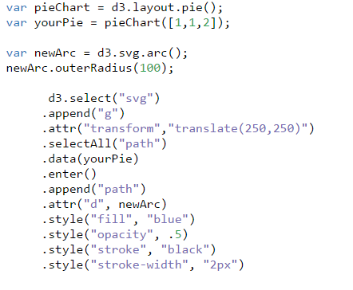
Pie Charts
Transformed data
(Meeks, Elijah. "D3. js in Action." (2015))
Original data
d3.layout.pie()
Creates an array of objects with start and end angles
Together with the generator d3.svg.arc, make each of the pieces of the pie chart

Slide 52
More “Layout” examples
Histograms, Pack layouts, Trees, Stack layouts

Slide 53
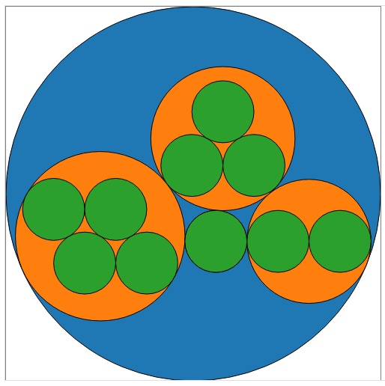
Pack layouts
useful for representing nested data
Each tweet is represented
by a green circle
nested inside an orange circle
that represents the user who made
the tweet. The users are all nested
inside a blue circle (C) that
represents the “root” node.
http://bl.ocks.org/emeeks/48891098d7fa619ad6ac

Slide 54
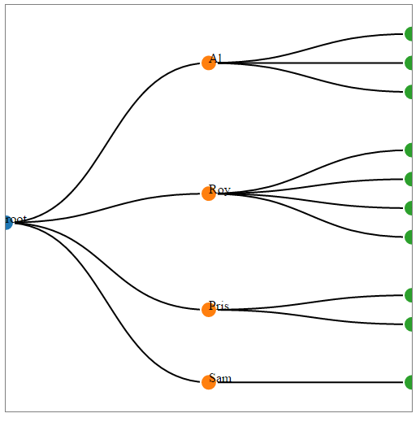
Trees
Another way to show hierarchical data
http://bl.ocks.org/emeeks/68728605f74113bc38dc

Slide 55

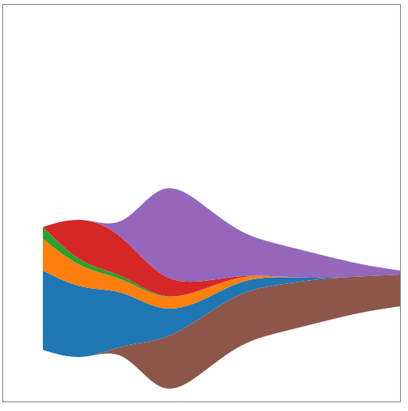
Stack layout
stacked graph
stream graph
http://bl.ocks.org/emeeks/862f941999ae2c05e4f6

Slide 56


Network visualization
..also with force-directed algorithms
Meeks, Elijah. "D3. js in Action." (2015).

Slide 57


Geospatial information visualization
Meeks, Elijah. "D3. js in Action." (2015).

